Slide 1
CS481/CS583: Bioinformatics Algorithms
Can Alkan
EA509
calkan@cs.bilkent.edu.tr
http://www.cs.bilkent.edu.tr/~calkan/teaching/cs481/

Slide 2
Contents
CS481/CS583: Bioinformatics Algorithms
GUIDE TREES AND EVOLUTIONARY TREES
Early Evolutionary Studies
Evolution and DNA Analysis: the Giant Panda Riddle
Evolutionary Tree of Bears and Raccoons
Evolutionary Trees: DNA-based Approach
Out of Africa Hypothesis
Human Evolutionary Tree (cont’d)
Evolutionary Tree of Humans (mtDNA)
Evolutionary Tree of Humans: (microsatellites)
Evolutionary Trees
Evolutionary Trees
Rooted and Unrooted Trees
Distances in Trees
Distance in Trees: an Example
Distance Matrix
Edit Distance vs. Tree Distance
Fitting Distance Matrix
Fitting Distance Matrix
Reconstructing a 3 Leaved Tree
Reconstructing a 3 Leaved Tree (cont’d)
Trees with > 3 Leaves
Distance Based Phylogeny Problem
UPGMA
UPGMA: Unweighted Pair Group Method with Arithmetic Mean
UPGMA’s Weakness
UPGMA’s Weakness: Example
Clustering in UPGMA
UPGMA Algorithm
UPGMA Algorithm (cont’d)
UPGMA example
UPGMA example
UPGMA Tree
NEIGHBOR JOINING
Additive Distance Matrices
Using Neighboring Leaves to Construct the Tree
Finding Neighboring Leaves
Finding Neighboring Leaves
Finding Neighboring Leaves
Neighbor Joining Algorithm
Degenerate Triples
Looking for Degenerate Triples
Shortening Hanging Edges to Produce Degenerate Triples
Finding Degenerate Triples
Reconstructing Trees for Additive Distance Matrices
AdditivePhylogeny Algorithm
AdditivePhylogeny (cont’d)
The Four Point Condition
The Four Point Condition (cont’d)
The Four Point Condition: Theorem
Least Squares Distance Phylogeny Problem
Alignment Matrix vs. Distance Matrix
MAX PARSIMONY
Character-Based Tree Reconstruction
Character-Based Tree Reconstruction (cont’d)
Parsimony Approach to Evolutionary Tree Reconstruction
Parsimony and Tree Reconstruction
Small Parsimony Problem
Weighted Small Parsimony Problem
Scoring Matrices
Unweighted vs. Weighted
Unweighted vs. Weighted
Weighted Small Parsimony Problem: Formulation
Sankoff’s Algorithm
Sankoff Algorithm: Dynamic Programming
Sankoff Algorithm (cont.)
Sankoff Algorithm (cont.)
Sankoff Algorithm (cont.)
Sankoff Algorithm (cont.)
Sankoff Algorithm (cont.)
Sankoff Algorithm (cont.)
Sankoff Algorithm (cont.)
Sankoff Algorithm: Traveling down the Tree
Sankoff Algorithm (cont.)
Sankoff Algorithm (cont.)
FITCH’S ALGORITHM
Fitch’s Algorithm
Fitch’s Algorithm (cont’d)
Fitch Algorithm
Fitch Algorithm (cont.)
Fitch Algorithm (cont.)
Fitch vs. Sankoff
Fitch
Comparison of Fitch and Sankoff
Sankoff
Sankoff vs. Fitch
Large Parsimony Problem
Large Parsimony Problem (cont.)

Slide 3
GUIDE TREES AND EVOLUTIONARY TREES
PHYLOGENETIC TREE CONSTRUCTION

Slide 4
Early Evolutionary Studies
Anatomical features were the dominant criteria used to derive evolutionary relationships between species since Darwin till early 1960s
The evolutionary relationships derived from these relatively subjective observations were often inconclusive. Some of them were later proved incorrect

Slide 5
Evolution and DNA Analysis: the Giant Panda Riddle
For roughly 100 years scientists were unable to figure out which family the giant panda belongs to
Giant pandas look like bears but have features that are unusual for bears and typical for raccoons, e.g., they do not hibernate
In 1985, Steven O’Brien and colleagues solved the giant panda classification problem using DNA sequences and algorithms

Slide 6
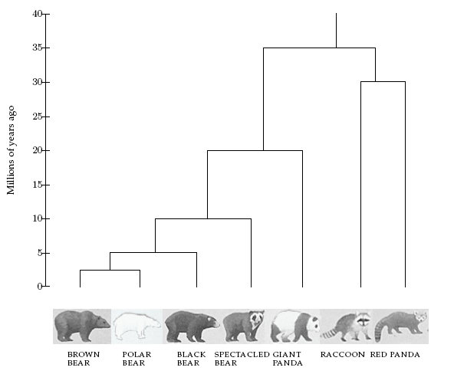
Evolutionary Tree of Bears and Raccoons

Slide 7
Evolutionary Trees: DNA-based Approach
40 years ago: Emile Zuckerkandl and Linus Pauling brought reconstructing evolutionary relationships with DNA into the spotlight
In the first few years after Zuckerkandl and Pauling proposed using DNA for evolutionary studies, the possibility of reconstructing evolutionary trees by DNA analysis
Now it is a dominant approach to study evolution.

Slide 8
Out of Africa Hypothesis
Around the time the giant panda riddle was solved, a DNA-based reconstruction of the human evolutionary tree led to the Out of Africa Hypothesis that claims our common ancestor lived in Africa roughly 200,000 years ago

Slide 9
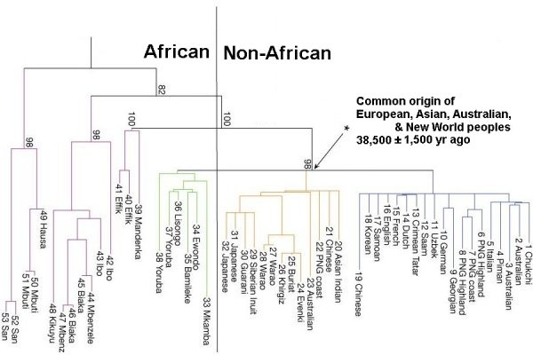
Human Evolutionary Tree (cont’d)
http://www.mun.ca/biology/scarr/Out_of_Africa2.htm

Slide 10
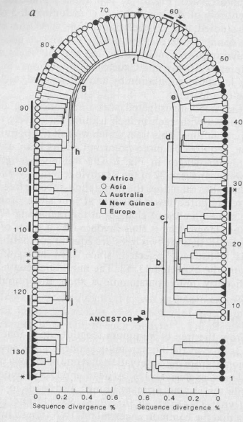
Evolutionary Tree of Humans (mtDNA)
The evolutionary tree separates one group of Africans from a group containing all five populations.
Vigilant, Stoneking, Harpending, Hawkes, and Wilson (1991)

Slide 11
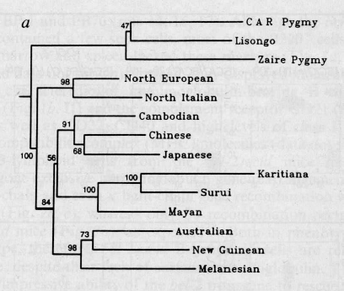
Evolutionary Tree of Humans: (microsatellites)
Neighbor joining tree for 14 human populations genotyped with 30 microsatellite loci.

Slide 12
Evolutionary Trees
How are these trees built from DNA sequences?

Slide 13
Evolutionary Trees
How are these trees built from DNA sequences?
leaves represent existing species
internal vertices represent ancestors
root represents the oldest evolutionary ancestor

Slide 14
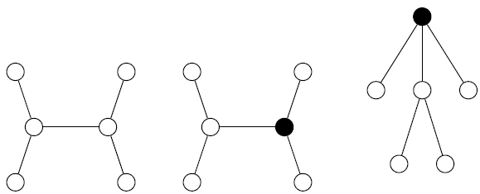
Rooted and Unrooted Trees
In the unrooted tree the position of the root (“oldest ancestor”) is unknown. Otherwise, they are like rooted trees

Slide 15
Distances in Trees
Edges may have weights reflecting:
Number of mutations on evolutionary path from one species to another
Time estimate for evolution of one species into another
In a tree T, we often compute
d_{ij}(T) - the length of a path between leaves i and j
d_{ij}(T) – tree distance between i and j

Slide 16
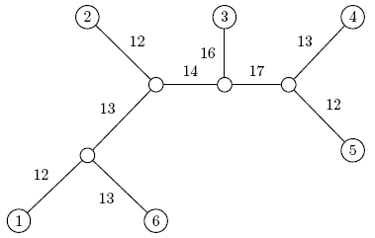
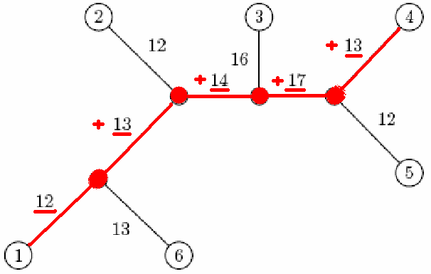
Distance in Trees: an Example
j
i
d_{1,4} = 12 + 13 + 14 + 17 + 12 = 68

Slide 17
Distance Matrix
Given n species, we can compute the n x n distance matrix D_{ij}
D_{ij} may be defined as the edit distance between a gene in species i and species j, where the gene of interest is sequenced for all n species.
D_{ij} – edit distance between i and j

Slide 18
Edit Distance vs. Tree Distance
Given n species, we can compute the n x n distance matrix D_{ij}
D_{ij} may be defined as the edit distance between a gene in species i and species j, where the gene of interest is sequenced for all n species.
D_{ij} – edit distance between i and j
Note the difference with
d_{ij}(T) – tree distance between i and j

Slide 19
Fitting Distance Matrix
Given n species, we can compute the n x n distance matrix D_{ij}
Evolution of these genes is described by a tree that we don’t know.
We need an algorithm to construct a tree that best fits the distance matrix D_{ij}

Slide 20
Fitting Distance Matrix
Fitting means D_{ij} = d_{ij}(T)
Lengths of path in an (unknown) tree T
Edit distance between species (known)

Slide 21
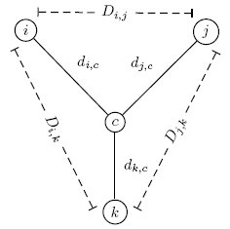
Reconstructing a 3 Leaved Tree
Tree reconstruction for any 3x3 matrix is straightforward
We have 3 leaves i, j, k and a center vertex c
Observe:
d_{ic} + d_{jc} = D_{ij}
d_{ic} + d_{kc} = D_{ik}
d_{jc} + d_{kc} = D_{jk}
Unknown c (root) -> Steiner Tree Problem

Slide 22
Reconstructing a 3 Leaved Tree (cont’d)
d_{ic} + d_{jc} = D_{ij}
+ d_{ic} + d_{kc} = D_{ik}
2d_{ic} + d_{jc} + d_{kc} = D_{ij} + D_{ik}
2d_{ic} + D_{jk} = D_{ij} + D_{ik}
d_{ic} = (D_{ij} + D_{ik} – D_{jk})/2
Similarly,
d_{jc} = (D_{ij} + D_{jk} – D_{ik})/2
d_{kc} = (D_{ki} + D_{kj} – D_{ij})/2

Slide 23
Trees with > 3 Leaves
A tree with n leaves has 2n-3 edges
This means fitting a given tree to a distance matrix D requires solving a system of “n choose 2” equations with 2n-3 variables
This is not always possible to solve optimally for n > 3

Slide 24
Distance Based Phylogeny Problem
Goal: Reconstruct an evolutionary tree from a distance matrix
Input: n x n distance matrix D_{ij}
Output: weighted tree T with n leaves fitting D
If D is additive, this problem has a solution and there is a simple algorithm to solve it

Slide 25
UPGMA

Slide 26
UPGMA: Unweighted Pair Group Method with Arithmetic Mean
UPGMA is a clustering algorithm that:
computes the distance between clusters using average pairwise distance
assigns a height to every vertex in the tree, effectively assuming the presence of a molecular clock and dating every vertex

Slide 27
UPGMA’s Weakness
The algorithm produces an ultrametric tree : the distance from the root to any leaf is the same
UPGMA assumes a constant molecular clock: all species represented by the leaves in the tree are assumed to accumulate mutations (and thus evolve) at the same rate. This is a major pitfalls of UPGMA.

Slide 28
UPGMA’s Weakness: Example
Correct tree
3
2
UPGMA
4
1
4
2
3
1

Slide 29
Clustering in UPGMA
Given two disjoint clusters C_{i}, C_{j} of sequences,
1
d_{ij} = ––––––––– Σ_{{p ∈Ci, q ∈Cj}}d_{pq}
|C_{i}| × |C_{j}|
Note that if C_{k} = C_{i} ∪ C_{j}, then distance to another cluster C_{l} is:
d_{il} |C_{i}| + d_{jl} |C_{j}|
d_{kl} = ––––––––––––––
|C_{i}| + |C_{j}|

Slide 30
UPGMA Algorithm
Initialization:
Assign each x_{i} to its own cluster C_{i}
Define one leaf per sequence, each at height 0
Iteration:
Find two clusters C_{i} and C_{j} such that d_{ij} is min
Let C_{k} = C_{i} ∪ C_{j}
Add a vertex connecting C_{i}, C_{j} and place it at height d_{ij} /2
Delete C_{i} and C_{j}
Termination:
When a single cluster remains

Slide 31
UPGMA Algorithm (cont’d)
1
4
3
2
5
1
4
2
3
5

Slide 32
UPGMA example
Constructing the phylogenetic tree construction using UPGMA for the
following score matrix:
 | A | B | C | D | E | F
A
B | 19
C | 27 | 31
D | 8 | 18 | 26
E | 33 | 36 | 41 | 31
F | 18 | 1 | 32 | 17 | 35

Slide 33
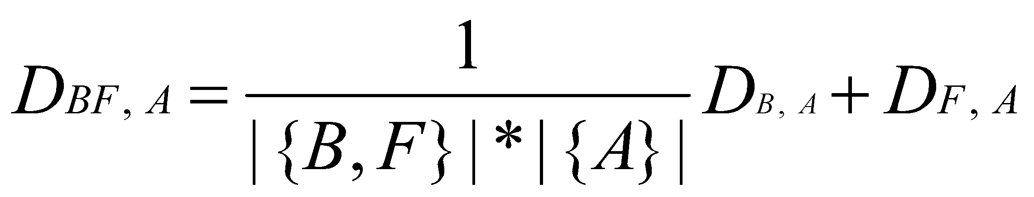
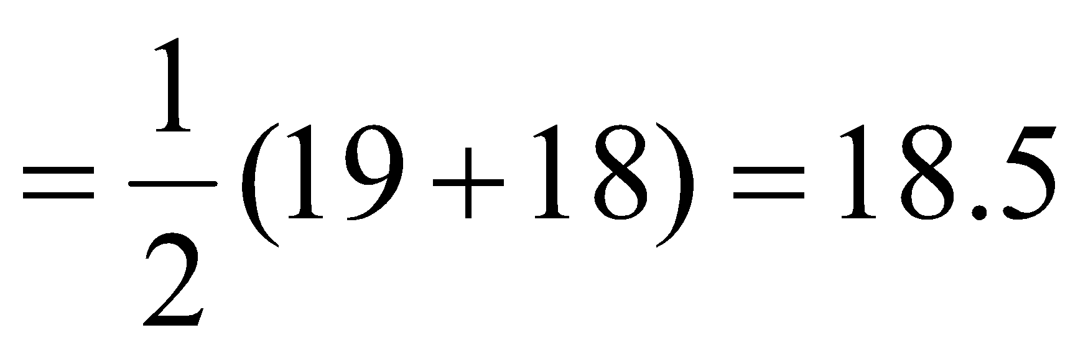
UPGMA example
C = {A,C, D, E, (B,F)}
 | A | B | C | D | E | F
A
B | 19
C | 27 | 31
D | 8 | 18 | 26
E | 33 | 36 | 41 | 31
F | 18 | 1 | 32 | 17 | 35
 | A | BF | C | D | E
A
BF | 18.5
C | 27 | 31.5
D | 8 | 17.5 | 26
E | 33 | 35.5 | 41 | 31
h_{BF} = ½ = 0.5

Slide 34
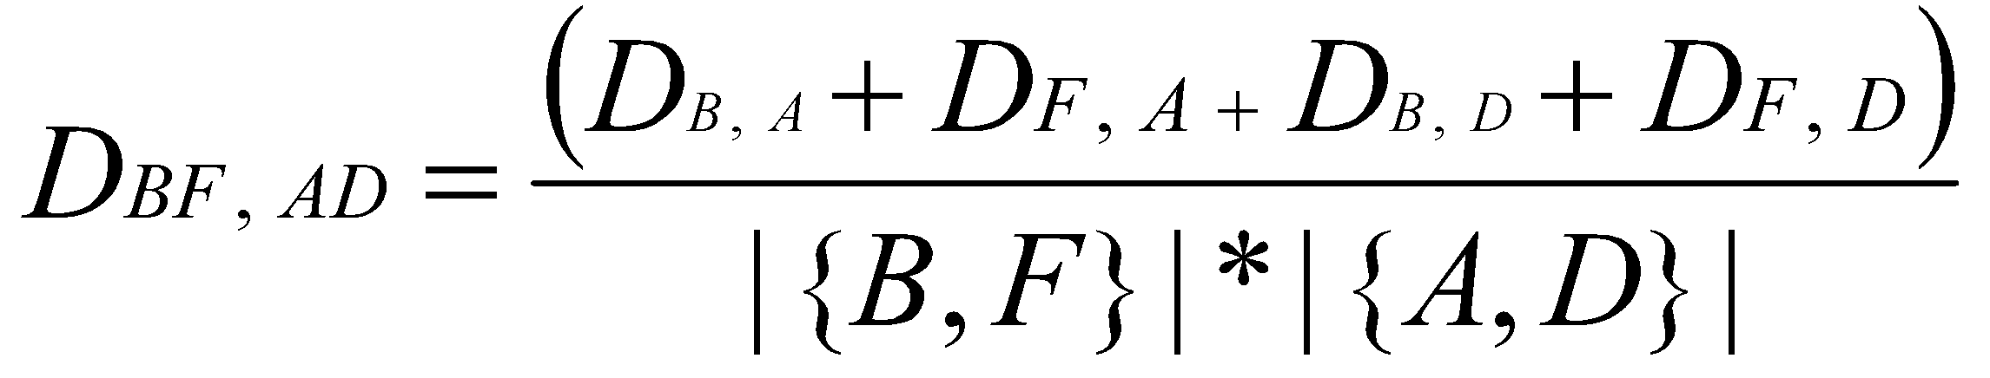
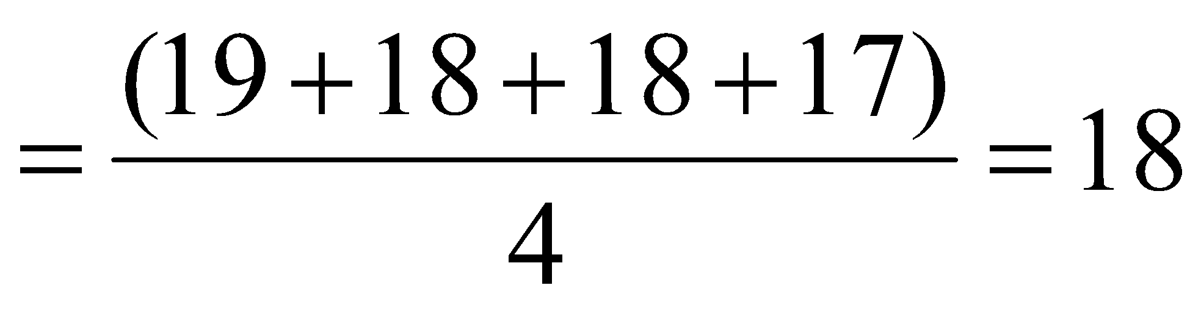
UPGMA example
C = {(A,D),C, E, (B,F)}
 | A | BF | C | D | E
A
BF | 18.5
C | 27 | 31.5
D | 8 | 17.5 | 26
E | 33 | 35.5 | 41 | 31
 | AD | BF | C | E
AD
BF | 18
C | 26.5 | 31.5
E | 32 | 35.5 | 41
h_{BF} = ½ = 0.5
h_{AD} = 8/2 = 4
h_{ADBF} = 18/2 = 9

Slide 35
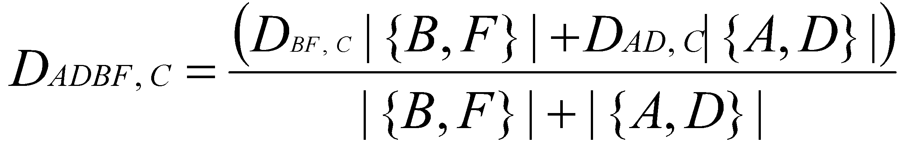
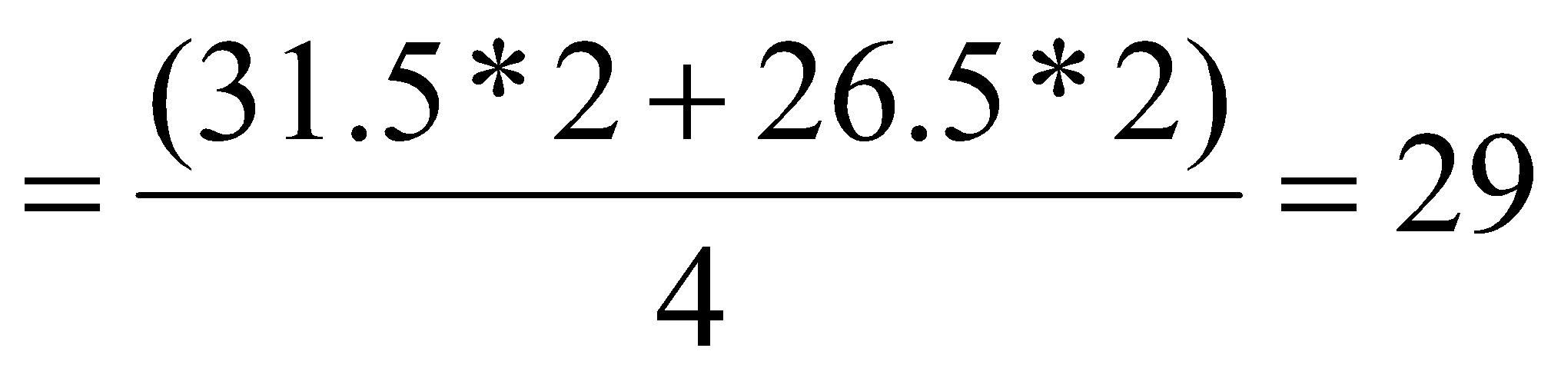
UPGMA example
C = {((B,F),(A,D)),C, E}
 | AD | BF | C | E
AD
BF | 18
C | 26.5 | 31.5
E | 32 | 35.5 | 41
 | ADBF | C | E
ADBF
C | 29
E | 33.75 | 41
h_{BF} = ½ = 0.5
h_{AD} = 8/2 = 4
h_{ADBF} = 18/2 = 9
h_{ADBFC} = 29/2 = 14.5

Slide 36
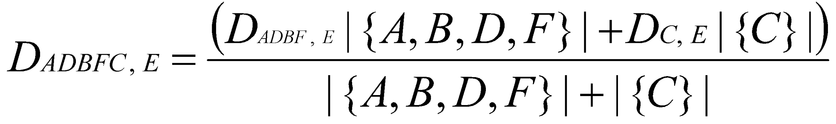
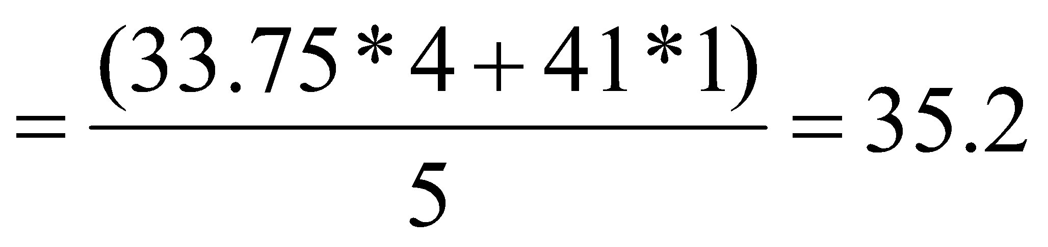
UPGMA example
C = {(((B,F),(A,D)),C), E}
 | ADBF | C | E
ADBF
C | 29
E | 33.75 | 41
 | ADBFC | E
ADBFC
E | 35.2
h_{BF} = ½ = 0.5
h_{AD} = 8/2 = 4
h_{ADBF} = 18/2 = 9
h_{ADBFC} = 29/2 = 14.5
h_{ADBFCE} = 35.2/2 = 17.6

Slide 37
UPGMA Tree
3.1
5.5
5
8.5
17.6
14.5
4
0.5
B F A D C E

Slide 38
NEIGHBOR JOINING

Slide 39
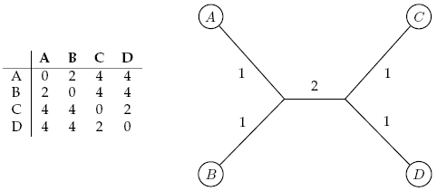

Additive Distance Matrices
Matrix D is ADDITIVE if there exists a tree T with d_{ij}(T) = D_{ij}
NON-ADDITIVE otherwise

Slide 40
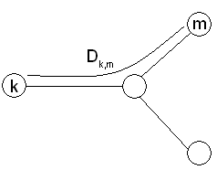
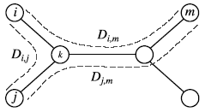
Using Neighboring Leaves to Construct the Tree
Find neighboring leaves i and j with parent k
Remove the rows and columns of i and j
Add a new row and column corresponding to k, where the distance from k to any other leaf m can be computed as:
D_{km} = (D_{im} + D_{jm} – D_{ij})/2
Compress i and j into k, iterate algorithm for rest of tree

Slide 41
Finding Neighboring Leaves
To find neighboring leaves we simply select a pair of closest leaves.

Slide 42
Finding Neighboring Leaves
To find neighboring leaves we simply select a pair of closest leaves.
WRONG

Slide 43
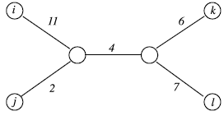
Finding Neighboring Leaves
Closest leaves aren’t necessarily neighbors
i and j are neighbors, but (d_{ij} = 13) > (d_{jk} = 12)
Finding a pair of neighboring leaves is
a nontrivial problem!

Slide 44
Neighbor Joining Algorithm
In 1987 Naruya Saitou and Masatoshi Nei developed a neighbor joining algorithm for phylogenetic tree reconstruction
Finds a pair of leaves that are close to each other but far from other leaves: implicitly finds a pair of neighboring leaves
Advantages: works well for additive and other non-additive matrices, it does not have the flawed molecular clock assumption

Slide 45
Degenerate Triples
A degenerate triple is a set of three distinct elements 1≤i,j,k≤n where D_{ij} + D_{jk} = D_{ik}
Element j in a degenerate triple i,j,k lies on the evolutionary path from i to k (or is attached to this path by an edge of length 0).

Slide 46
Looking for Degenerate Triples
If distance matrix D has a degenerate triple i,j,k then j can be “removed” from D thus reducing the size of the problem.
If distance matrix D does not have a degenerate triple i,j,k, one can “create” a degenerate triple in D by shortening all hanging edges (in the tree).

Slide 47
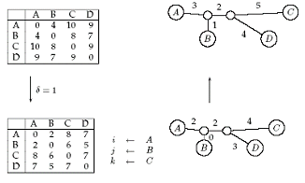
Shortening Hanging Edges to Produce Degenerate Triples
Shorten all “hanging” edges (edges that connect leaves) until a degenerate triple is found

Slide 48
Finding Degenerate Triples
If there is no degenerate triple, all hanging edges are reduced by the same amount δ, so that all pair-wise distances in the matrix are reduced by 2δ.
Eventually this process collapses one of the leaves (when δ = length of shortest hanging edge), forming a degenerate triple i,j,k and reducing the size of the distance matrix D.
The attachment point for j can be recovered in the reverse transformations by saving D_{ij} for each collapsed leaf.

Slide 49
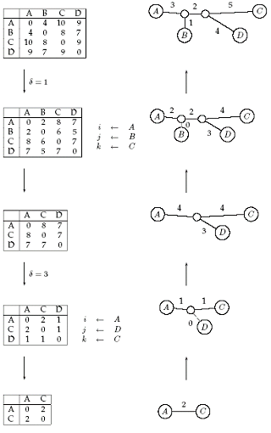
Reconstructing Trees for Additive Distance Matrices

Slide 50
AdditivePhylogeny Algorithm
AdditivePhylogeny(D)
if D is a 2 x 2 matrix
T = tree of a single edge of length D_{1,2}
return T
if D is non-degenerate
δ = trimming parameter of matrix D
for all 1 ≤ i ≠ j ≤ n
D_{ij} = D_{ij} - 2δ
else
δ = 0

Slide 51
AdditivePhylogeny (cont’d)
Find a triple i, j, k in D such that D_{ij} + D_{jk} = D_{ik}
x = D_{ij}
Remove j^{th} row and j^{th} column from D
T = AdditivePhylogeny(D)
Add a new vertex v to T at distance x from i to k
Add j back to T by creating an edge (v,j) of length 0
for every leaf l in T
if distance from l to v in the tree ≠ D_{l,j}
output “matrix is not additive”
return
Extend all “hanging” edges by length δ
return T

Slide 52
The Four Point Condition
AdditivePhylogeny provides a way to check if distance matrix D is additive
An even more efficient additivity check is the “four-point condition”
Let 1 ≤ i,j,k,l ≤ n be four distinct leaves in a tree

Slide 53
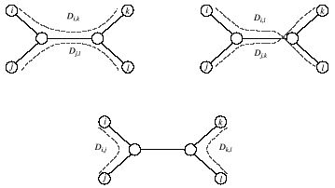
The Four Point Condition (cont’d)
Compute: 1. D_{ij} + D_{kl}, 2. D_{ik} + D_{jl}, 3. D_{il} + D_{jk}
2
3
1
2 and 3 represent the same number: the length of all edges + the middle edge (it is counted twice)
1 represents a smaller number: the length of all edges – the middle edge

Slide 54
The Four Point Condition: Theorem
The four point condition for the quartet i,j,k,l is satisfied if two of these sums are the same, with the third sum smaller than these first two
Theorem : An n x n matrix D is additive if and only if the four point condition holds for every quartet 1 ≤ i,j,k,l ≤ n

Slide 55
Least Squares Distance Phylogeny Problem
If the distance matrix D is NOT additive, then we look for a tree T that approximates D the best:
Squared Error : ∑_{i,j} (d_{ij}(T) – D_{ij})²
Squared Error is a measure of the quality of the fit between distance matrix and the tree: we want to minimize it.
Least Squares Distance Phylogeny Problem: finding the best approximation tree T for a non-additive matrix D (NP-hard).

Slide 56

Alignment Matrix vs. Distance Matrix
Sequence a gene of length m nucleotides in n species to generate an…
n x m alignment matrix
CANNOT be transformed back into alignment matrix because information was lost on the forward transformation
Transform into…
n x n distance matrix

Slide 57
MAX PARSIMONY

Slide 58
Character-Based Tree Reconstruction
Better technique:
Character-based reconstruction algorithms use the n x m alignment matrix
(n = # species, m = #characters)
directly instead of using distance matrix.
GOAL: determine what character strings at internal nodes would best explain the character strings for the n observed species

Slide 59
Character-Based Tree Reconstruction (cont’d)
Characters may be nucleotides, where A, G, C, T are states of this character.
By setting the length of an edge in the tree to the Hamming distance, we may define the parsimony score of the tree as the sum of the lengths (weights) of the edges

Slide 60
Parsimony Approach to Evolutionary Tree Reconstruction
Applies Occam’s razor principle to identify the simplest explanation for the data
Assumes observed character differences resulted from the fewest possible mutations
Seeks the tree that yields lowest possible parsimony score - sum of cost of all mutations found in the tree

Slide 61
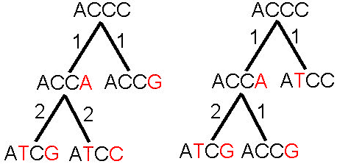

Parsimony and Tree Reconstruction

Slide 62
Small Parsimony Problem
Input: Tree T with each leaf labeled by an m-character string.
Output: Labeling of internal vertices of the tree T minimizing the parsimony score.
Because the characters in the string are independent, the Small Parsimony problem can be solved independently for each character. Therefore, to devise an algorithm, we can assume that every leaf is labeled by a single character rather than by a string of m characters.

Slide 63
Weighted Small Parsimony Problem
A more general version of Small Parsimony Problem
Input includes a k * k scoring matrix describing the cost of transformation of each of k states into another one
For Small Parsimony problem, the scoring matrix is based on Hamming distance
d_{H}(v, w) = 0 if v=w
d_{H}(v, w) = 1 otherwise

Slide 64
Scoring Matrices
Small Parsimony Problem
Weighted Parsimony Problem
 | A | T | G | C
A | 0 | 1 | 1 | 1
T | 1 | 0 | 1 | 1
G | 1 | 1 | 0 | 1
C | 1 | 1 | 1 | 0
 | A | T | G | C
A | 0 | 3 | 4 | 9
T | 3 | 0 | 2 | 4
G | 4 | 2 | 0 | 4
C | 9 | 4 | 4 | 0

Slide 65
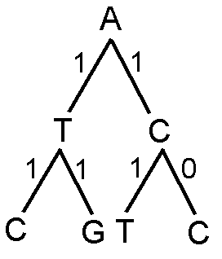
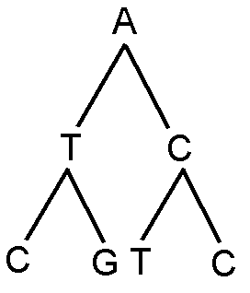
Unweighted vs. Weighted
Small Parsimony Scoring Matrix:
 | A | T | G | C
A | 0 | 1 | 1 | 1
T | 1 | 0 | 1 | 1
G | 1 | 1 | 0 | 1
C | 1 | 1 | 1 | 0
Small Parsimony Score:
5

Slide 66
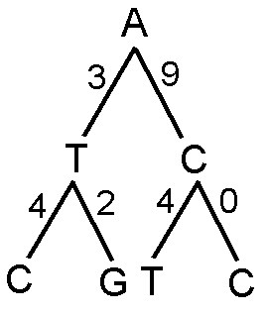
Unweighted vs. Weighted
Weighted Parsimony Scoring Matrix:
 | A | T | G | C
A | 0 | 3 | 4 | 9
T | 3 | 0 | 2 | 4
G | 4 | 2 | 0 | 4
C | 9 | 4 | 4 | 0
Weighted Parsimony Score: 22

Slide 67
Weighted Small Parsimony Problem: Formulation
Input: Tree T with each leaf labeled by elements of a k-letter alphabet and a k x k scoring matrix (δ_{ij})
Output: Labeling of internal vertices of the tree T minimizing the weighted parsimony score

Slide 68
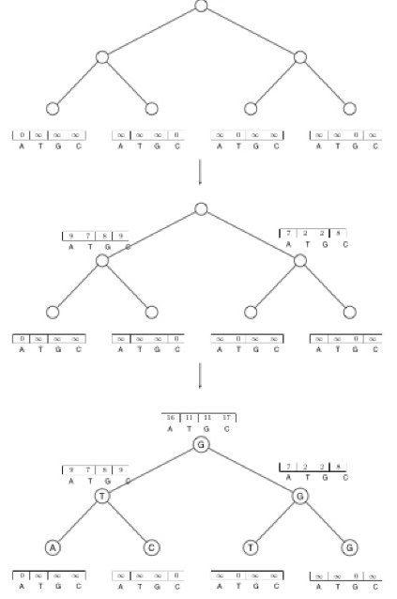
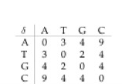
Sankoff’s Algorithm
Check children’s every vertex and determine the minimum between them
An example

Slide 69
Sankoff Algorithm: Dynamic Programming
Calculate and keep track of a score for every possible label at each vertex
s_{t}(v) = minimum parsimony score of the subtree rooted at vertex v if v has character t
The score at each vertex is based on scores of its children:
s_{t}(parent) = min_{i} {s_{i}( left child ) + δ_{i, t}} +
min_{j} {s_{j}( right child ) + δ_{j, t}}

Slide 70
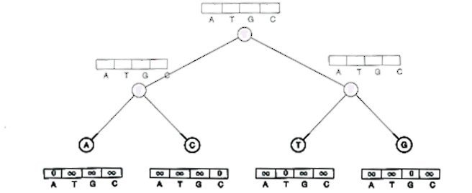
Sankoff Algorithm (cont.)
Begin at leaves:
If leaf has the character in question, score is 0
Else, score is ∞

Slide 71
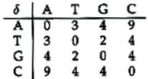
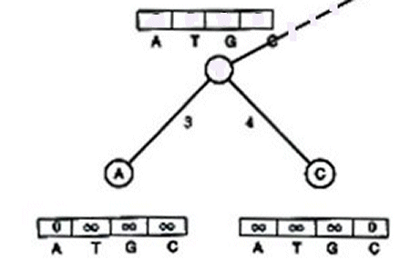
Sankoff Algorithm (cont.)
s_{t}(v) = min_{i} {s_{i}(u) + δ_{i, t}} + min_{j}{s_{j}(w) + δ_{j, t}}
 | s_{i}(u) | δ_{i, A} | sum
A | 0 | 0 | 0
T | ∞ | 3 | ∞
G | ∞ | 4 | ∞
C | ∞ | 9 | ∞
 | s_{i}(u) | δ_{i, A} | sum
A | 0 | 0 | 0
T | ∞ | 3 | ∞
G | ∞ | 4 | ∞
C | ∞ | 9 | ∞
 | s_{i}(u) | δ_{i, A} | sum
A
T
G
C
s_{A}(v) = min_{i}{s_{i}(u) + δ_{i, A}} + min_{j}{s_{j}(w) + δ_{j, A}}
s_{A}(v) = 0

Slide 72
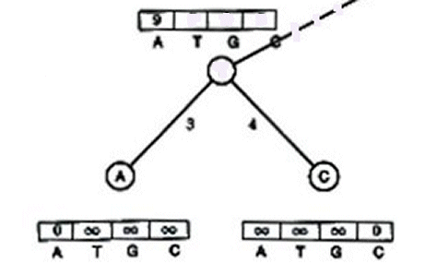
Sankoff Algorithm (cont.)
s_{t}(v) = min_{i} {s_{i}(u) + δ_{i, t}} + min_{j}{s_{j}(w) + δ_{j, t}}
 | s_{j}(u) | δ_{j, A} | sum
A
T
G
C
 | s_{j}(u) | δ_{j, A} | sum
A | ∞ | 0 | ∞
T | ∞ | 3 | ∞
G | ∞ | 4 | ∞
C | 0 | 9 | 9
 | s_{j}(u) | δ_{j, A} | sum
A | ∞ | 0 | ∞
T | ∞ | 3 | ∞
G | ∞ | 4 | ∞
C | 0 | 9 | 9
s_{A}(v) = min_{i}{s_{i}(u) + δ_{i, A}} + min_{j}{s_{j}(w) + δ_{j, A}}
s_{A}(v) = 0
+ 9 = 9

Slide 73
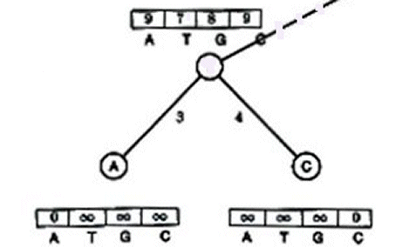
Sankoff Algorithm (cont.)
s_{t}(v) = min_{i} {s_{i}(u) + δ_{i, t}} + min_{j}{s_{j}(w) + δ_{j, t}}
Repeat for T, G, and C

Slide 74
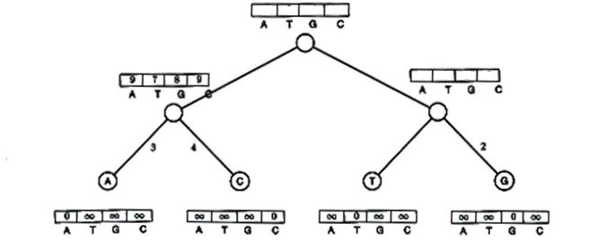
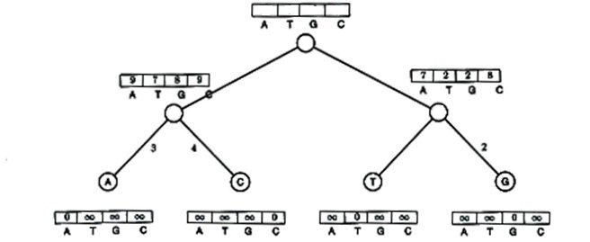
Sankoff Algorithm (cont.)
Repeat for right subtree

Slide 75
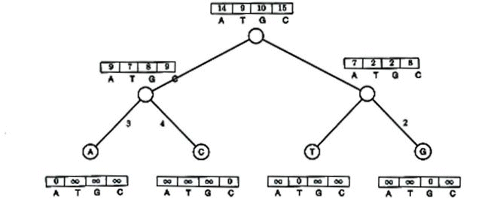
Sankoff Algorithm (cont.)
Repeat for root

Slide 76
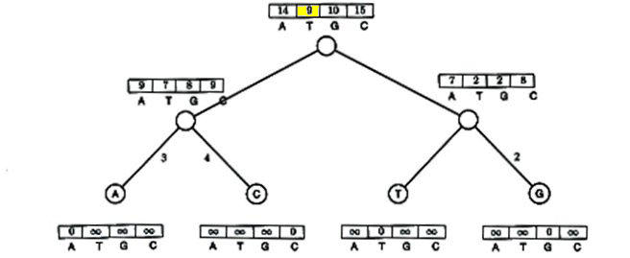

Sankoff Algorithm (cont.)
Smallest score at root is minimum weighted parsimony score
In this case, 9 – so label with T

Slide 77
Sankoff Algorithm: Traveling down the Tree
The scores at the root vertex have been computed by going up the tree
After the scores at root vertex are computed the Sankoff algorithm moves down the tree and assign each vertex with optimal character.

Slide 78
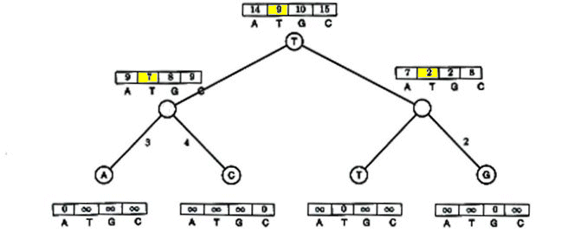

Sankoff Algorithm (cont.)
9 is derived from 7 + 2
So left child is T,
And right child is T

Slide 79
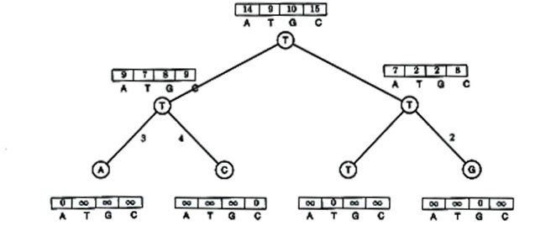
Sankoff Algorithm (cont.)
And the tree is thus labeled…

Slide 80
FITCH’S ALGORITHM

Slide 81
Fitch’s Algorithm
Solves Small Parsimony problem
Dynamic programming in essence
Assigns a set of letters to every vertex in the tree.
If the two children’s sets of characters overlap, it’s the common set of them
If not, it’s the combined set of them.

Slide 82
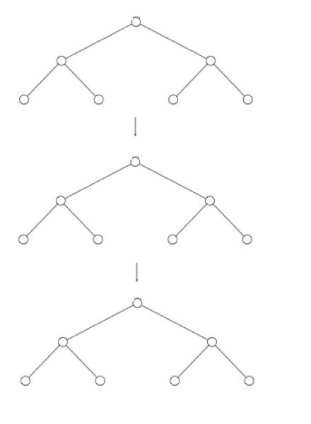
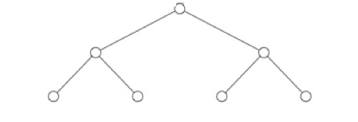

Fitch’s Algorithm (cont’d)
An example:
a
c
t
a
{a,c}
{t,a}
a
c
t
a
a
a
a
a
{a,c}
{t,a}
a
a
a
c
t
a
c
t

Slide 83
Fitch Algorithm
1) Assign a set of possible letters to every vertex, traversing the tree from leaves to root
Each node’s set is the combination of its children’s sets (leaves contain their label)
E.g. if the node we are looking at has a left child labeled {A, C} and a right child labeled {A, T}, the node will be given the set {A, C, T}

Slide 84
Fitch Algorithm (cont.)
2) Assign labels to each vertex, traversing the tree from root to leaves
Assign root arbitrarily from its set of letters
For all other vertices, if its parent’s label is in its set of letters, assign it its parent’s label
Else, choose an arbitrary letter from its set as its label

Slide 85
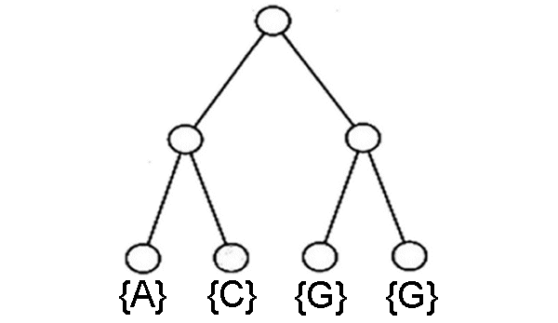
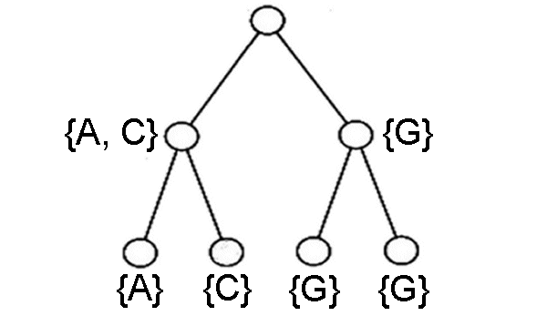
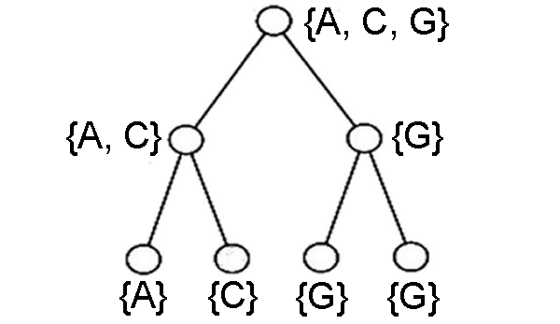
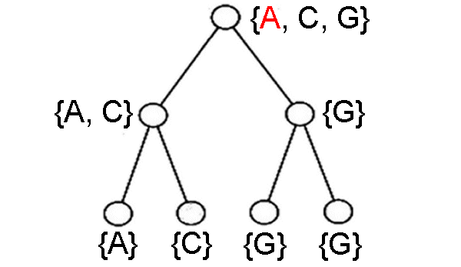
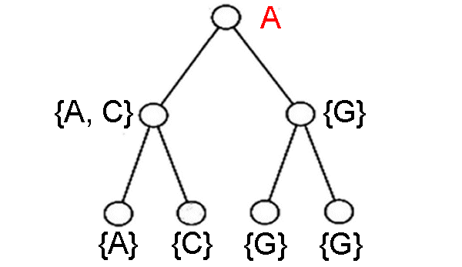
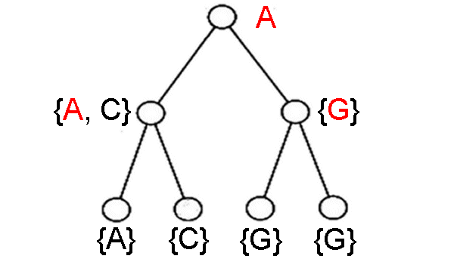
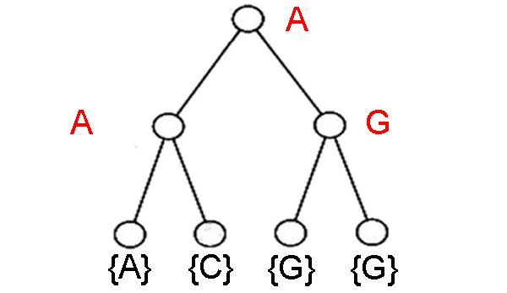
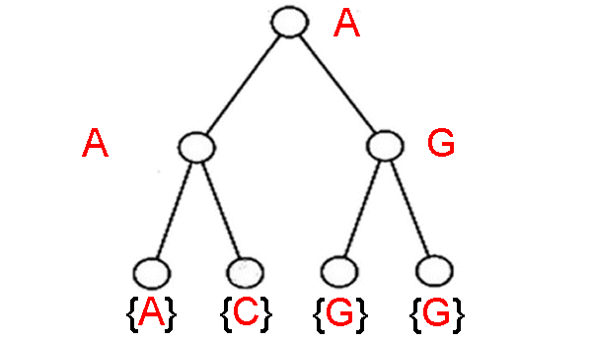

Fitch Algorithm (cont.)

Slide 86
Fitch vs. Sankoff
Both have an O(nk) runtime
Are they actually different?
Let’s compare …

Slide 87
Fitch
As seen previously:

Slide 88
Comparison of Fitch and Sankoff
As seen earlier, the scoring matrix for the Fitch algorithm is merely:
So let’s do the same problem using Sankoff algorithm and this scoring matrix
 | A | T | G | C
A | 0 | 1 | 1 | 1
T | 1 | 0 | 1 | 1
G | 1 | 1 | 0 | 1
C | 1 | 1 | 1 | 0

Slide 89

Sankoff

Slide 90
Sankoff vs. Fitch
The Sankoff algorithm gives the same set of optimal labels as the Fitch algorithm
For Sankoff algorithm, character t is optimal for vertex v if s_{t}(v) = min_{1<i<k}s_{i}(v)
Denote the set of optimal letters at vertex v as S(v)
If S(left child) and S(right child) overlap, S(parent) is the intersection
Else it’s the union of S(left child) and S(right child)
This is also the Fitch recurrence
The two algorithms are identical

Slide 91
Large Parsimony Problem
Input: An n x m matrix M describing n species, each represented by an m-character string
Output: A tree T with n leaves labeled by the n rows of matrix M, and a labeling of the internal vertices such that the parsimony score is minimized over all possible trees and all possible labelings of internal vertices

Slide 92
Large Parsimony Problem (cont.)
Possible search space is huge, especially as n increases
(2n – 3)! possible rooted trees
(2n – 5)! possible unrooted trees
Problem is NP-complete
Exhaustive search only possible w/ small n(< 10)
Hence, branch and bound or heuristics used

